Slide 1
Python(3) Intro

Slide 2
Topics
Short intro
Ways to work with Python
Python Basics
Choose interaction type
Variables
Simple
Complex
Controls
Functions

Slide 3
Python Intro
Created in 1991
Scripted Language
Emphasis on code readability
Generally portable across platforms

Slide 4
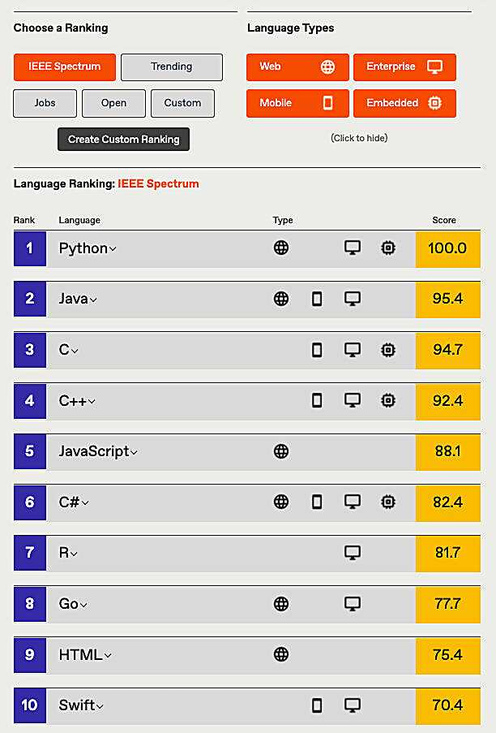
Popularity

Slide 5
Ways to work with Python
REPL (Read Evaluate Print Loop, CLI effectively)
Browser
Notebook
IDE (we will be using VS Code)

Slide 6
Choose Interaction Type
Browser (https://www.w3schools.com/python/trypython.asp?filename=demo_default)
Jupyter Notebook (online example: https://hub.mybinder.turing.ac.uk/user/ipython-ipython-in-depth-frg4hwy1/notebooks/examples/IPython%20Kernel/Untitled.ipynb?kernel_name=python3)
REPL (Not recommended other than to try out one liners. Needs local Python installation)
IDE (VS Code, please install through self service on mac and follow this short set up tutorial: https://www.youtube.com/watch?v=1-6vFzoiPBw)

Slide 7
Variables
You do not need to declare variables before using them (not best practice though!), or declare their type. Every variable in Python is an object.
Simple
String
Numbers
Complex/Data Types
Set
List
Tuple
Dictionary

Slide 8
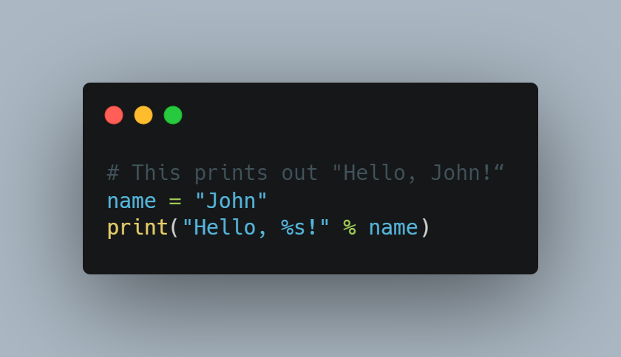
Simple Variables
String
Strings are defined either with a single quote or a double quotes.
A beginner’s gotcha is to mistakenly store numbers intended for calculation as strings like so:
MyVariable = “3529”
On the other hand if you want to store something like Account ID, though numeric there are no calculations involved and so should be stored as string.

Slide 9
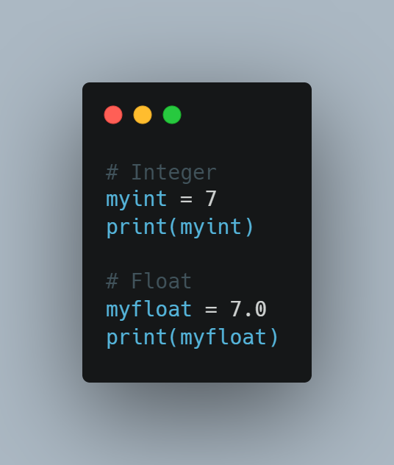
Simple Variables
Number
Python supports two types of numbers - integers(whole numbers) and floating point numbers(decimals). (It also supports complex numbers, which we will not cover)
Hands-on Lab:
Copy, paste and run this code in your preferred way on interacting with Python - https://raw.githubusercontent.com/gk95/PythonBasics/main/BasicVariables.py

Slide 10
Data Types Glossary
Indexed
We can access the item by their 'index' for e.g myarray[1] or myarray['Name']
Ordered
When we say ordered, it means that the items have a defined order, and that order will not change.
Unchangeable
Meaning that we cannot change, add or remove items after the data type has been created.
Allow Duplicates
They can or cannot have items with the same value

Slide 11
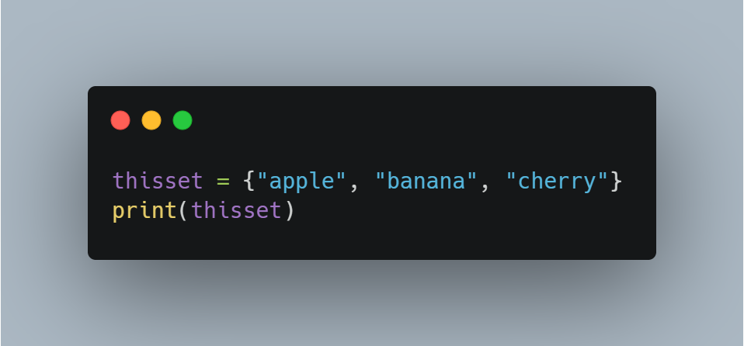
Complex/Data Types Typically used to store and process multiple items in a single variable.
Set
A set is a collection which do not allow duplicate values and is unordered, unchangeable*, and unindexed.
* Note: Set items are unchangeable, but you can remove items and add new items.

Slide 12
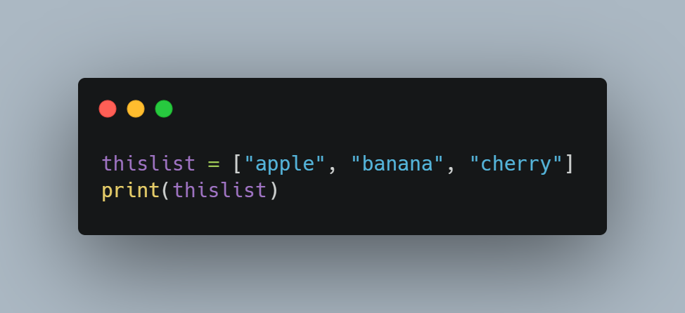
List
List items are ordered, changeable, and allow duplicate values.
List items are indexed, the first item has index [0], the second item has index [1] etc

Slide 13
Dictionary
Dictionaries are used to store data values in key:value pairs.
A dictionary is a collection which is ordered*, changeable and does not allow duplicates
*As of Python version 3.7, dictionaries are ordered. In Python 3.6 and earlier, dictionaries are unordered.
Hands-on Lab:
Copy, paste and run this code in your preferred way on interacting with Python - https://raw.githubusercontent.com/gk95/PythonBasics/main/Dictonary.py

Slide 14
Tuple
Tuple is a collection which is ordered and unchangeable.
Tuples are written with round brackets

Slide 15
Data Type cheat sheet
Data Type | Ordered | Changeable | Duplicate Allowed | Indexed
Set | No | No | No | No
List | Yes | Yes | Yes | Yes
Dictionary | Yes | Yes | No | Yes
Tuple | Yes | No | Yes | Yes

Slide 16
Controls
If..else
While
For Loops
Not in scope for this session

Slide 17
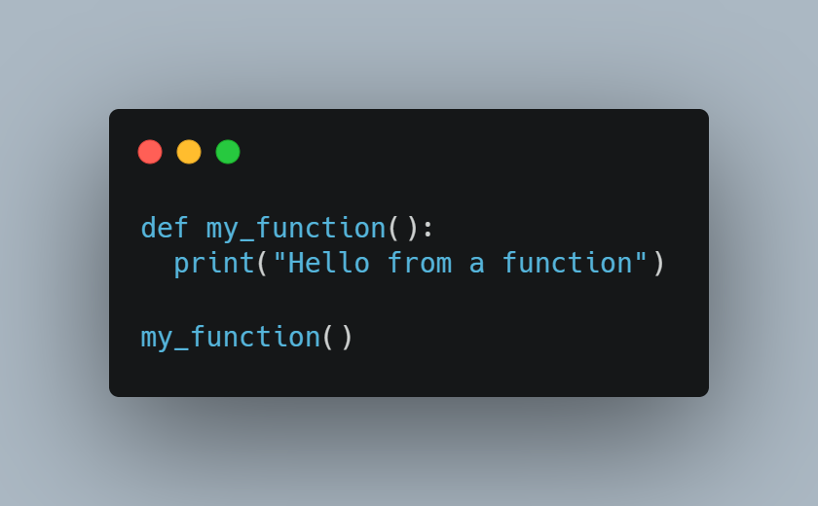
Functions
A function is a block of code which only runs when it is called.
You can pass data, known as parameters, into a function.
A function can return data as a result.
Hands-on Lab:
Copy, paste and run this code in your preferred way on interacting with Python - https://raw.githubusercontent.com/gk95/PythonBasics/main/Functions.py

Slide 18
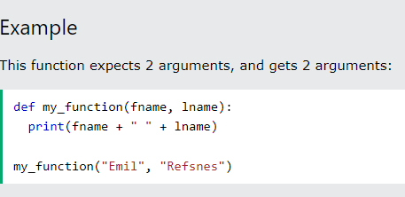
Functions continued
By default, a function must be called with the correct number of arguments.
Meaning that if your function expects 2 arguments, you have to call the function with 2 arguments, not more, and not less

Slide 19
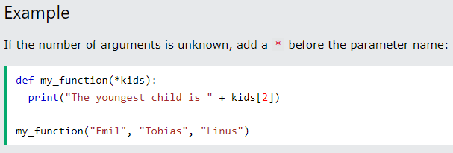
Functions continued
Arbitrary Arguments, *args
If the number of arguments that will be passed into a function is unknown, add a * before the parameter name in the function definition.
This way the function will receive a tuple of arguments, and can access the items accordingly:

Slide 20
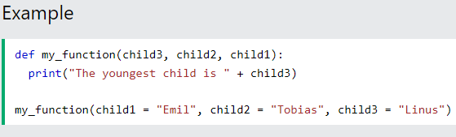
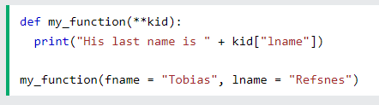
Functions continued
Keyword Arguments
You can also send arguments with the key = value syntax. This way the order of the arguments does not matter
Arbitrary Keyword Arguments, **kwargs
If the number of keyword arguments is unknown, add a double ** before the parameter name:

Slide 21
Code Management Basics
Basic GIT workflow and commands
git checkout repo
git checkout -b branchname
Add/Edit/Delete files
git add –A .
git commit -m “change comment”
git push
Source code repo
IDE workflow

